Slide 1
Nanotechnology Resources in Chemistry Instruction
Why should we use nanotechnology to teach chemistry?
Notes:
We have some much to teach already, why did we need more?

Slide 2
Nanotechnology
Nanotechnology is the manipulation of matter at a scale of 1 to 100 nanometers.
Using nanotechnology we can control molecules at an atomic level and create materials with unique properties.
A nanometer is 10⁻⁹ (a billionth) of a meter. The prefix nano is Greek for dwarf.
As a reference point, a hair is approximately 100,000 nanometers.
A red blood cell is approximately 10,000 nanometers.

Slide 3
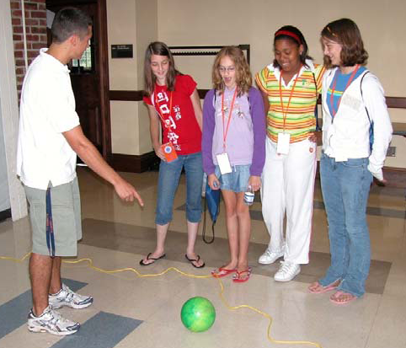
Scale of A Nanometer

Slide 4
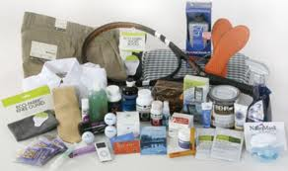
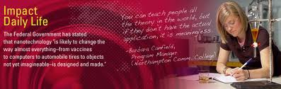
Nanotechnology is important
We can image atoms and molecules
We can create new materials
Many commercial products use nanotechnology
Our students are fascinated by nanotechnology
Notes:
Nanotechnology is here to stay.

Slide 5
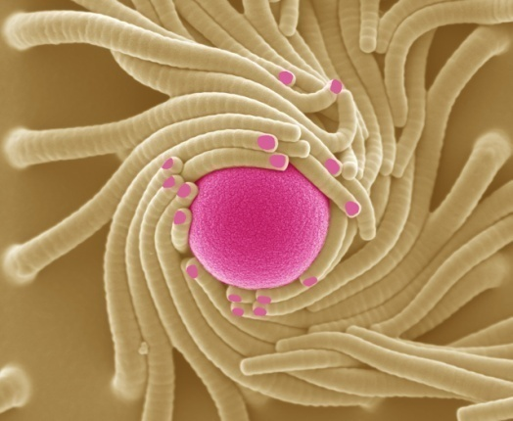
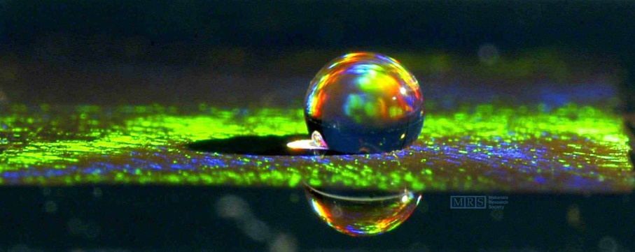
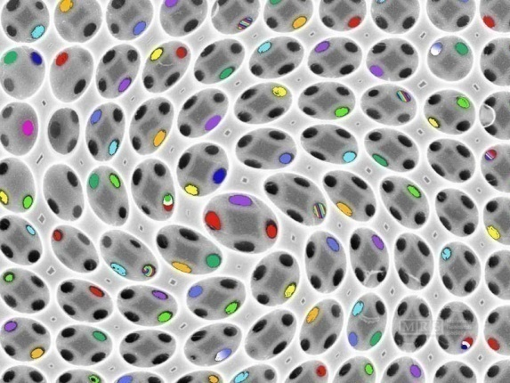
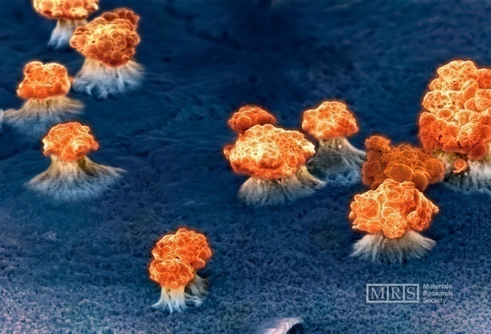
Nanotechnology – Seeing with new eyes
Notes:
The next generation of graduate students who will study nanoscience and nanotechnology are in middle and high school today.

Slide 6
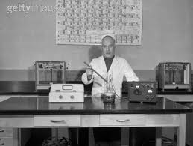
How can we use nanotechnology to teach core chemistry curriculum?

Slide 7
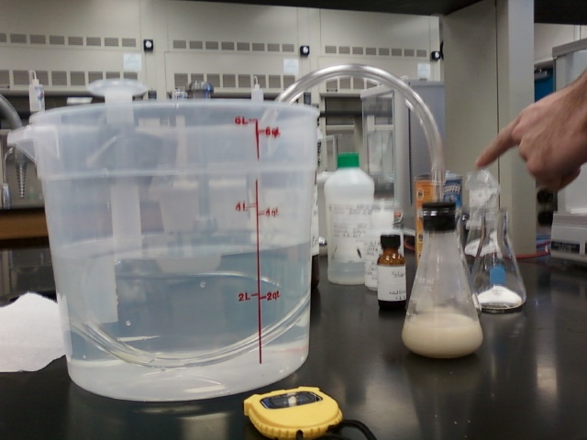
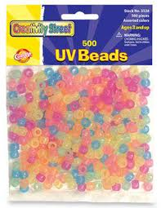
Low Tech Lab Activities
Biotoxicity of Colloidal Silver
UV Beads and Sunscreen

Slide 8
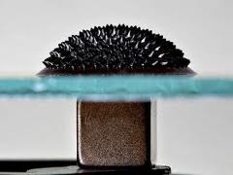
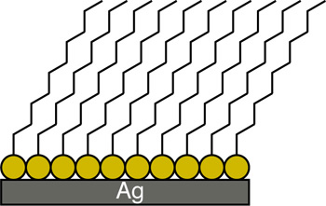
Medium Technology Activities
Superhydrophobic Surfaces
Ferrofluids
Photolithography

Slide 9
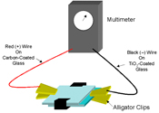
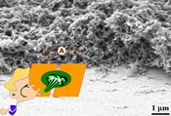
Medium to High Tech Activities
Solar Cells
Nanowire pH Sensors

Slide 10
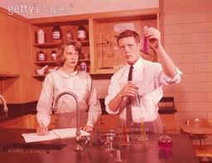
Where to start? Laboratory curriculum
Are there areas that can be improved by using a new low tech approach?
Trial the new lab activities during the summer session or with Honors or Chemistry club students
Work with the dept & stockroom to incorporate into standard curriculum

Slide 11
Where to add nanotechnology activities?
Introductory Chemistry
Sunscreen and UV Beads
Preparatory General Chemistry
Water Purification, Super hydrophobic surfaces
General Chemistry I, II
Biotoxicity, nanowire pH sensors, solar cells
Organic Chemistry ??

Slide 12
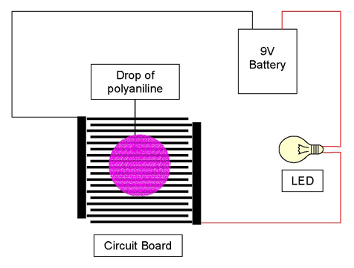
General Chemistry experiments with nanotechnology
Nanowire pH Sensors
Acid vapors lower the electrical resistance while base vapors increase it. The active sensing layer is polyaniline nanofibers deposited over brown (unbleached) paper and the electrodes are made of copper. .

Slide 13
Chemistry with nanotechnology
Start with an activity that meets student learning objectives for that class
Trial the lab activities during the summer session, possibly in an honors class
Get department, division, and stockroom support
Be careful not to overwhelm the students
Enjoy the activity and be ready to revise to fit your class
Notes:
Be careful not to overwhelm students with non-core chemistry concepts

Slide 14

High Tech Approach to teaching chemistry with nanotechnology
nanoprofessor.net
Notes:
Bring two copies of the textbook

Slide 15
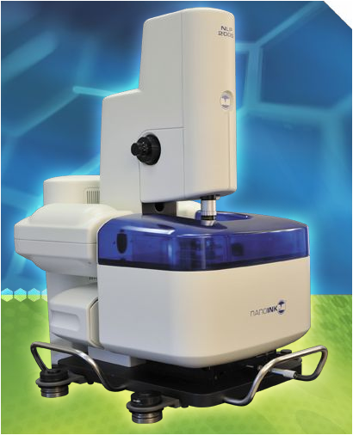
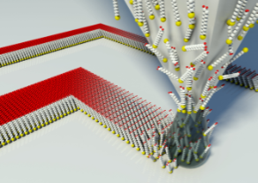
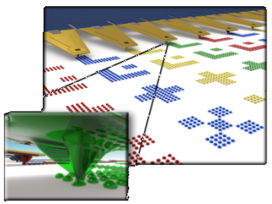
Nanolithography Platform (NLP)
Dip Pen Lithography
Source: NanoInk, Nanoprofessor Tools
Source: Wikipedia, Dip Pen Lithography

Slide 16
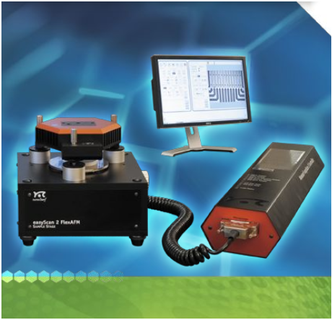
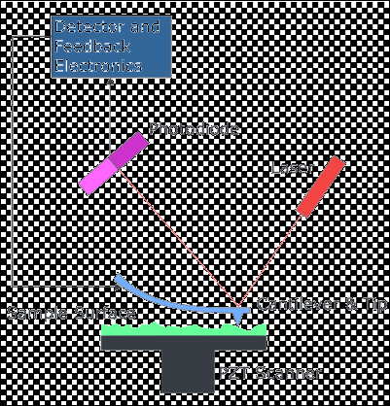
Atomic Force Microscope (AFM)
Source: NanoInk, Nanoprofessor Tools
Source: Wikipedia, Atomic Force Microscopes

Slide 17
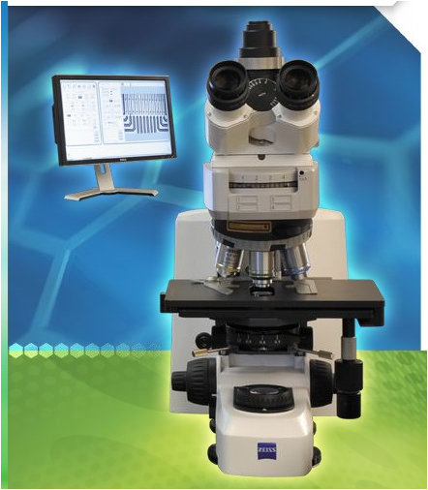
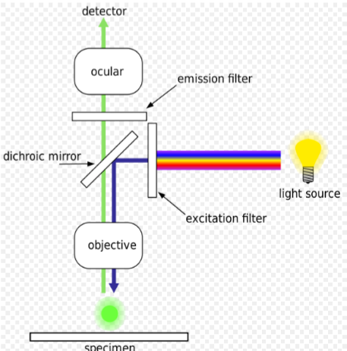
LED Fluorescent Microscope (FM)
Source: NanoInk, Nanoprofessor Tools
Source: Wikipedia, Fluorescent Microscopes

Slide 18
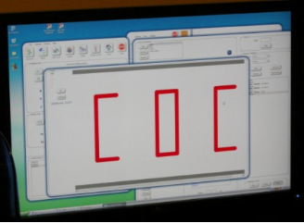
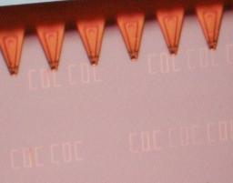
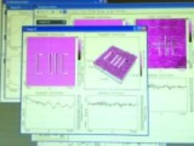
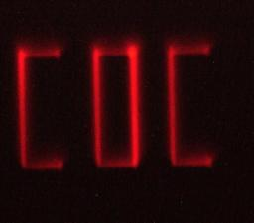
NLP
AFM
Instrumentation
FM

Slide 19
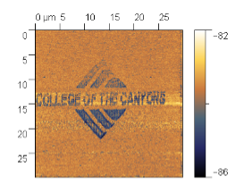
Applications
Nanolithography-
Masks for circuits
Biosensor arrays
Cell Adhesion, motility, and orientation studies
AFM
Nano surface imaging
Measurement and analysis
FM
Imaging
Detection
Diagnostics
Future: Solar technology, medical nanomaterials, consumer products, water treatment, research

Slide 20
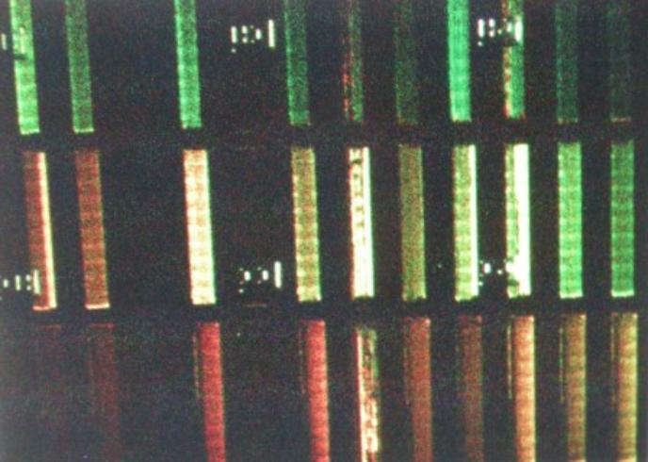
NLP DATA
Diffraction Grating

Slide 21
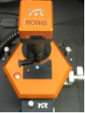
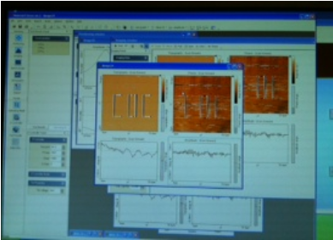
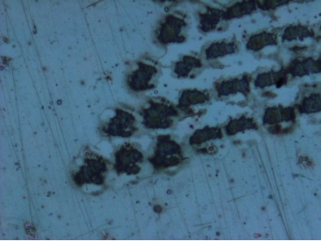
AFM Data
NLP inked patterns
Wrapping Paper- Point of Star

Slide 22
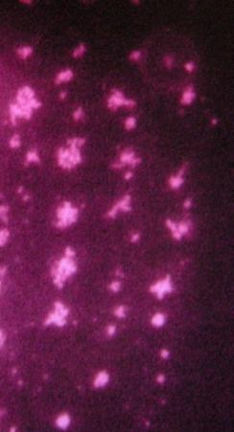
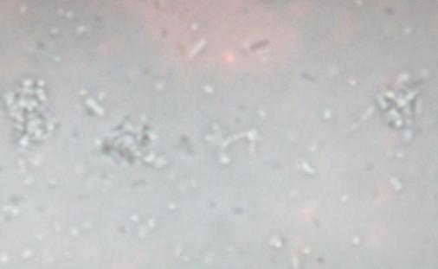
FM Data
Negatively Charged Bacteria (E. coli) aggregate on Positively Charged Dots of
Modified Lipids

Slide 23
nanoProfessor
Textbook, Introduction to Nanoscale Science and Technology, containing physics, chemistry, and biology sections with Practice Exercises, Quick Activities, and Section Review.
-It is a good textbook to teach an introduction to nanotechnology course. It is not a chemistry textbook.
Laboratory Manual, in revision, provides detailed information on training, sample preparation, NLP use, and sample analysis.
-It is not a chemistry lab manual
Training
Supplies
Introduction to Nanochemistry
Intro to Periodicity
Chemical Bonding
Intermolecular Forces
Nanoscale Structure
Practical Applications
Notes:
Bring two copies of textbook to share

Slide 25
How do I get from traditional wet chemistry laboratory experiments and activities to nanotechnology-based experiments? Training

Slide 26
Where do I find training and resources?
California NanoScience Institute (UCLA) http://cnsi.ctrl.ucla.edu/nanoscience/pages/homepage
California NanoScience Institute (UCSB)
http://www.nanotech.ucsb.edu/
University of Wisconsin Institute for Chemical Education (ICE)
http://ice.chem.wisc.edu/NanoCourse.html (starts June 10th, online)
http://mrsec.wisc.edu/Edetc/
Many national workshops (with funding) are available
Google – nanotechnology + chemistry + education

Slide 27
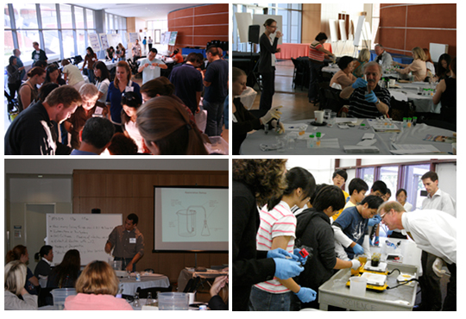
CNSI UCLA
Teacher Workshops held at the Westwood campus once per month
CNSI’s basic goal has been to find ways to integrate nanoscience experiments into the prescribed high school curriculum to help support science teachers teaching required fundamental science concepts, while at the same time introducing students to the new field of nanoscience.

Slide 28
NACK PennState www.nano4me.org
Post-Secondary Resources:
Introductory Level Modules: A series of thought-provoking nanotechnology PowerPoint presentations (used in NANO 010)
Undergraduate Level Course Notes: Packaged as six courses, each containing multiple modules. Each module can be rearranged to create new courses. Suitable for two-year degree programs, for certificate programs, and for freshman-sophomore use in four-year degree programs.
Undergraduate Level Laboratories: A set of six lab packages corresponding to the set of six course notes. Suitable for two-year degree programs, for certificate programs, and for freshman-sophomore use in four-year degree programs.
Remote Access: A collection of characterization equipment that may be remotely controlled through the Internet.

Slide 29
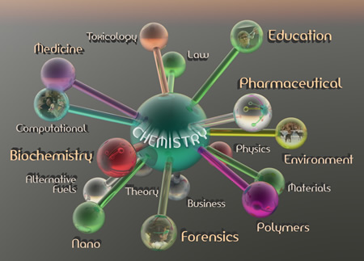
Nanotechnology is part of chemistry

